Slide 1


The Future of
Regtech
Revolutionizing Identity Verification and Regulatory Compliance
“We are creating the world’s first end-to-end AML platform.”

Slide 2



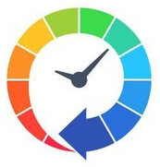
Problem Statement
Financial fraud and cybercrime costs businesses over $500 billion annually!
Over $3 trillion in illicit funds flowed through the global financial system in 2023!
Over 90% of global banks and 85% of mid-sized financial institutions are still relying on outdated, manual processes!
Current compliance methods are costly, time-consuming and are error prone!

Slide 3

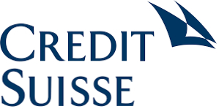
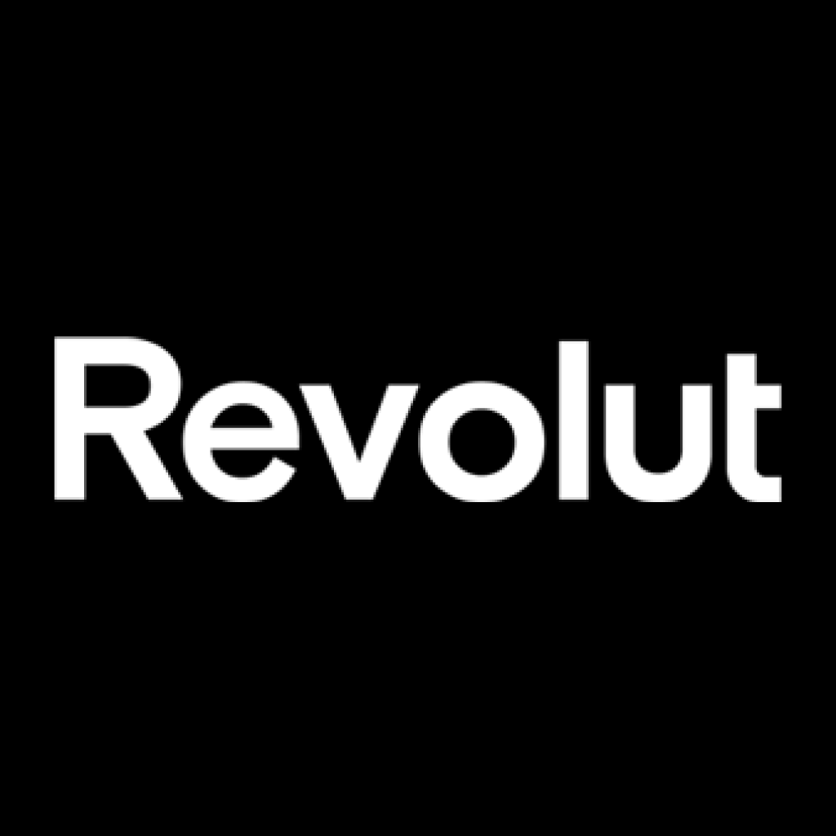

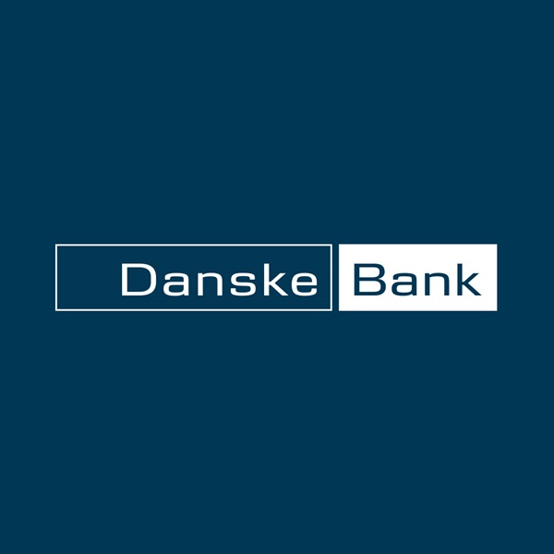



Need / Demand
Companies fined for regulatory & compliance breaches in 2023
$ 2.9M
€ 5.3M
£ 10M
$ 600M
$ 4.5M
€ 1.5M
$ 8.6M
The 2020 Wirecard collapse, involved €1.9 billion in missing funds, revealed large-scale fraud that went undetected due to weak compliance and manual oversight.

Slide 4
NorthRow Bridging the Gap -
Solution
Know Your Business (KYB)
Know Your Customer (KYC)
Digital Identity Verification
Ongoing Customer Monitoring
Customer Remediation
Supplier Due Diligence
Anti-Money Laundering (AML) Compliance
Right to Work verification

Slide 5

Growth Strategy
AI-Driven Automation
Strategic Client Expansion and
Market Penetration
Products
Enhance Compliance Accuracy
Predictive Insights
Proactive Risk Management
Operational Excellence
Streamline Process
Cost Reduction
Operational Optimization
Full-time headcount to be decreased
Address overstaffing
Nearshore & Offshore Resource engagement models
Target different geographies
Take Northrow Global – Expanding to new untapped markets – Driving growth
Focus on maximizing TCV

Slide 6

Product Roadmap -
Horizon One
Product Roadmap
2023
2024
2025
WorkStation v2
Configurable Web
Journeys
Enterprise
Readiness
Key Roadmap Items
Data Agnosticism
Data Agnosticism
Phase 1
Data Agnosticism
Phase 2
True Perpetual
KYC / KYB
Radically increase the scope and breadth of international data coverage, and potentially remove data from our supplier base
Insights Phase 1
Task and Case
Management V2
Gen-AI Document
Ingestion
WorkStation V2
Delivery of significantly widened automated use cases & more granular workflow control
Business Roadmap
Configurable Web Journeys
Allows users to build no-code web onboarding journeys pre-integrated with NorthRow deliverables through a responsive web application
Domestic Scaling and
Global Data Source
Expansion
Transaction Monitoring
Integration Through
Partnerships
Increasing ACV and
Moving up into the
Small & Mid
Enterprise Segments

Slide 7



Product Roadmap - Horizon Two
Areas of Focus
Generative/Retrieval AI
Independent AI Agents
Regulatory Changes
NorthRow is currently designing a Gen-AI powered document ingestion engine that will be used to help solve the UBO challenge in situations where the data is not currently available through traditional data suppliers. Delivering this would place NorthRow in a truly unique position, being able to provide a highly automated UBO flow even when traditional data sources fail.
NorthRow expects to develop a number of AI Agents. These AI Agents are self contained context aware services that can be tasked with slow and repetitive tasks ‘manual’ tasks not suited for traditional RPA, which will really enable the NorthRow platform to act as a member of the compliance team as well as tool used by the team.
As well as technology advances, NorthRow will continue to take advantage of regulatory enhancements, such as the expansion of the Digital Identity Trust Framework and new regulations around UBO Registration that will enable NorthRow to improve the quality of its services. NorthRow should look to be aggressive in its adoption of new regulations and the
opportunity they present.

Slide 8
Addressable Market
Global KYC/B/AML Spend
Drivers for Growth
Industry Transformation
Firms are looking for a next generation solution
Convergence
Global TAM: $7.5bn
(14% 4yr CAGR)
US –
$3.5bn
Firms are combining teams, data and analytics
Adoption
Europe –
$3.0bn
Adoption of advanced analytics and disruptive technologies
Automation
UK –
$900m
Automation is replacing manual and people-driven processes
UK KYB/C –
$600m
Regulation
Regulation is continuously demanding improvements
Mandated
The use of electronic CDD for continuous compliance where possible
FATF
Widening its programme of mutual assessment and enforcement
Sources: multiple (including OWI, Burton Taylor, Grand View Research, Statista, TechSci Research, Analytical Research Cognizance); $bn revenue for KYC/B/AML software

Slide 9
Market Opportunity
Total Addressable Market:
$21 Billion
Compliance costs for financial institutions are set to exceed $210 billion, as businesses struggle to keep pace with constantly evolving regulations
With over 80% of financial institutions poised to ramp up AI spending on compliance in the next five years, the market is ready for Northrow’s AI-powered solutions to revolutionize the landscape.
Total Addressable Market
$21 Billion
Compliance Costs for Financial Institutions
$210 Billion

Slide 10
Competitive Advantage
Extensive Experience - Existing customers – Fortune 500 + Top Tier Banks
AI Powered - End to End Product Offering – Faster – Reliable – Cost Effective
Freedom –
Data Agnostic
Integratable
Architecture

Slide 11







Why NorthRow Wins
Operational eiciencies and automation
Products designed to remove friction for compliance teams through activity tracking, reporting, automation and remediation
Wide Data Coverage
Global individual and company data coverage to assist with KYC, KYB and
AML regulations
Leading customer support
Best-in-class customer support, account management, implementation and ongoing technical expertise
End-to-end solution
Most comprehensive functionality from a single vendor satisfying automated onboarding compliance for B2C and B2B clients
Flexible and modular tech architecture
All capabilities delivered through UI or API for deep integration with clients’ existing systems
Ease of use out of the box
Simple to use, easy to configure and implemented in days rather than months. Complex processes are simplified

Slide 12
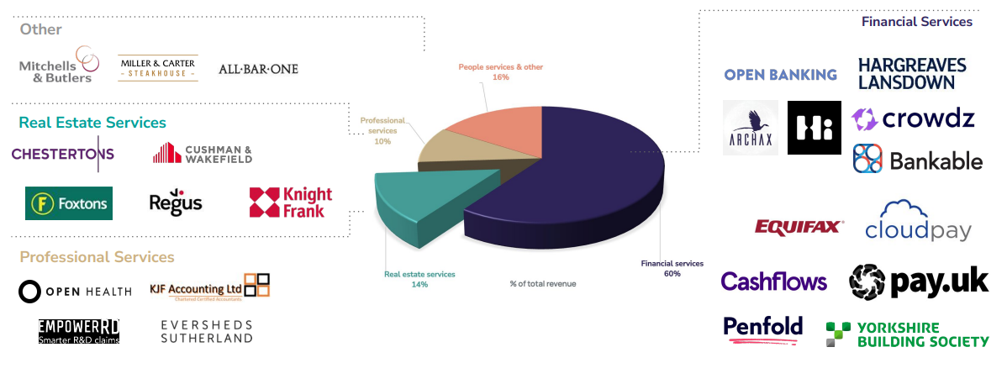
Deeply Entrenched Customer Base

Slide 13



Pricing
Standard
Premium
Standard
15,000£
35,000£
65,000£
per year
per year
per year

Slide 14

Financials
Current Revenue
£3M in revenue
Revenue Projections
10X through global expansion
Tapping into SAM from SOM
Growth Projections

Slide 15
Team
Umar Qadri
Umar Qadri
Umar Qadri
Functions
Designation
20 years of experience
Functions
Designation
20 years of experience
Functions
Designation
20 years of experience

Slide 16

Roadmap / Use of Funds
Product Development
Advanced AI-Powered Fraud Detection and Prediction Capabilities
Scalable, Modular AI Solutions
Explainable AI (XAI) for Compliance Transparency
AI-Driven Personalization and Adaptive Learning
Proactive Compliance Monitoring and Alerts
Integration with Existing Systems
Data Privacy and Security Through AI
Continuous Learning and Evolution of AI Models

Slide 17

Roadmap / Use of Funds
AI-Powered Customer Onboarding and Verification
Organizational
Development
Human-AI Collaboration Tools

Slide 18
Join us in revolutionizing the future of regulatory compliance.
Thank You!

